Slide 1

Object Oriented Programming
Creational Design Patterns: Singleton
IT560
Sourish Dasgupta
Assistant Professor, DA-IICT, Gandhinagar
https://daiict.ac.in/faculty/sourish-dasgupta

Slide 2
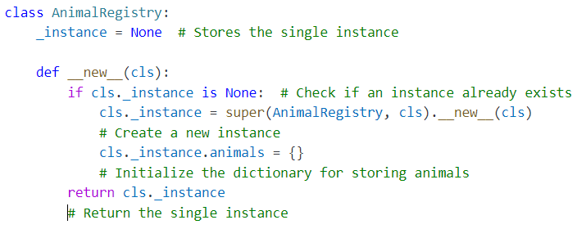
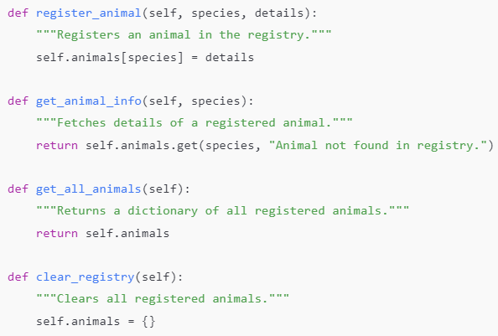
Singleton Design Pattern : Just one object!
Get method of dictionary animals
IT560: Creational Design Patterns: Singleton
Sourish Dasgupta

Slide 3
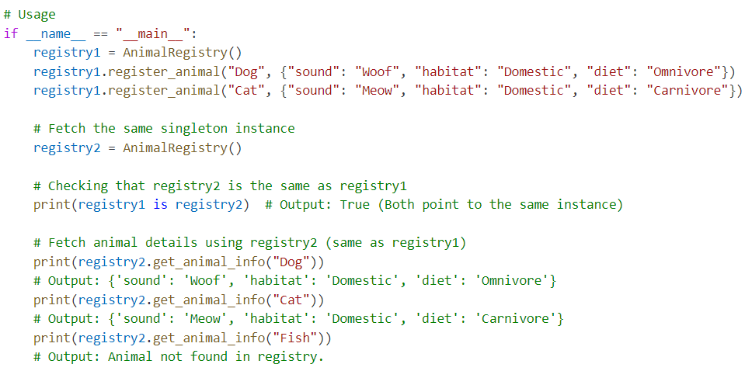
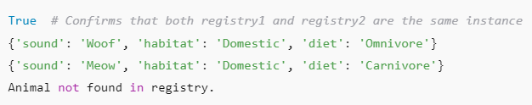
Singleton Design Pattern : Just one object!
IT560: Creational Design Patterns: Singleton
Sourish Dasgupta

Slide 4
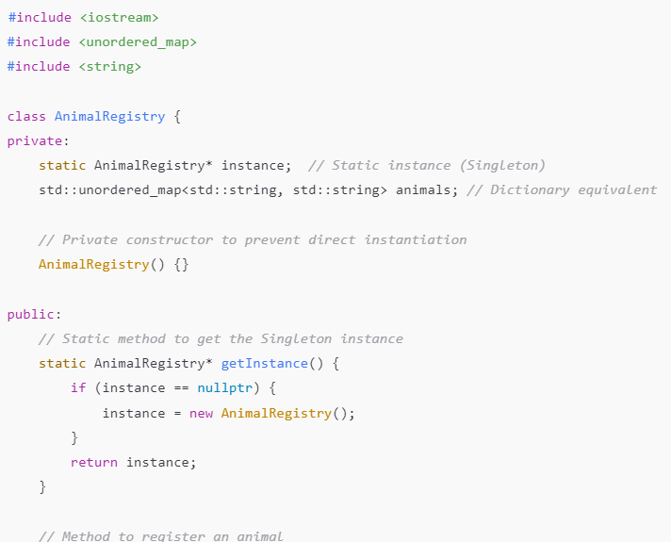

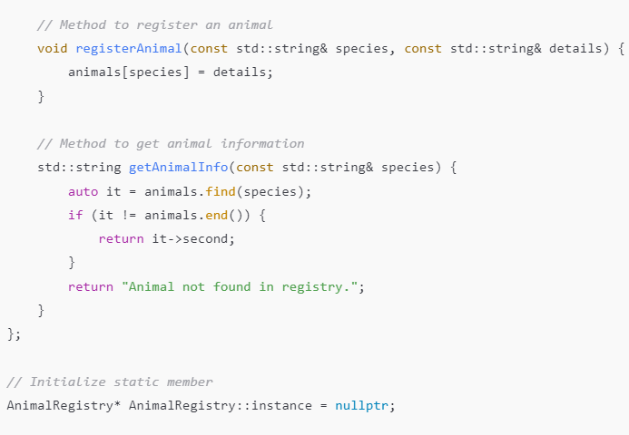
Singleton Design Pattern : In C++
Returns an iterator to the key-value pair
Don’t want unnecessary copies! Read-only is needed here
Check if instance already exists
IT560: Creational Design Patterns: Singleton
Sourish Dasgupta

Slide 5
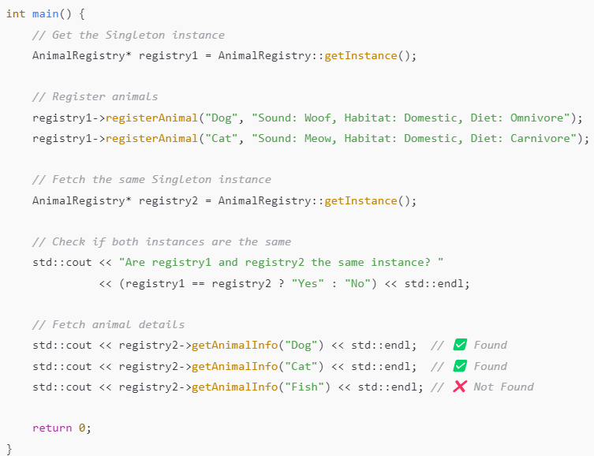
Singleton Design Pattern : In C++
IT560: Creational Design Patterns: Singleton
Sourish Dasgupta

Slide 6
Singleton Design Pattern: Post-mortem
✅ Future-proofing for inheritance
If AnimalRegistry ever inherits from another class, using super() ensures we call the correct __new__ method from the proper superclass.
✅ Maintains consistency
Using super() makes it clear that we’re using __new__ in the context of inheritance, even if AnimalRegistry currently doesn’t inherit from anything.
✅ Best Practice
super() ensures Python’s method resolution order (MRO) is followed, making the Singleton more maintainable.
Calls object.__new__(cls)
Why not object.__new__(cls)?
IT560: Creational Design Patterns: Singleton
Sourish Dasgupta

Slide 7
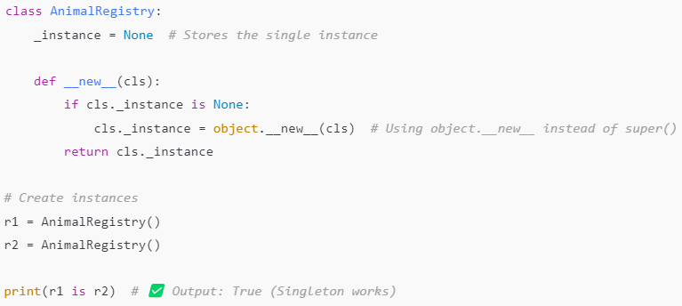
Singleton Design Pattern: w/o super()
Works!!
IT560: Creational Design Patterns: Singleton
Sourish Dasgupta

Slide 8
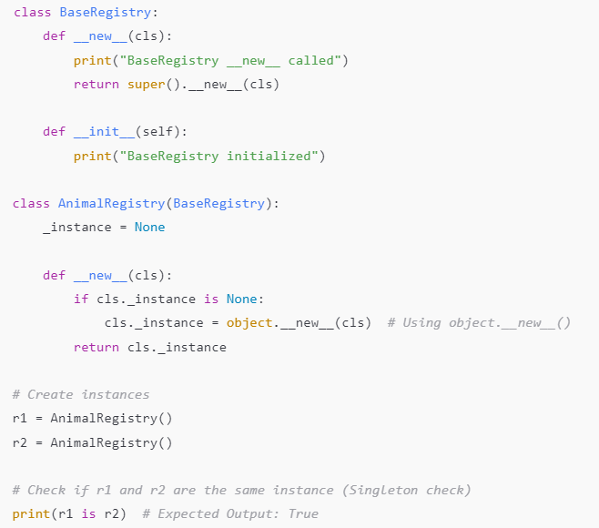

Singleton Design Pattern: w/o super()
✅ r1 is r2 prints True, confirming that AnimalRegistry is a Singleton.
❌ BaseRegistry.__new__() is not called at all because object.__new__(cls) is used, bypassing inheritance.
❌ BaseRegistry.__init__() is called twice because __init__ runs every time an instance is returned.
Works!!
IT560: Creational Design Patterns: Singleton
Sourish Dasgupta

Slide 9
Singleton Design Pattern: Handling Multiple Inheritance
Why not super().__new__(cls)?
IT560: Creational Design Patterns: Singleton
Sourish Dasgupta

Slide 10
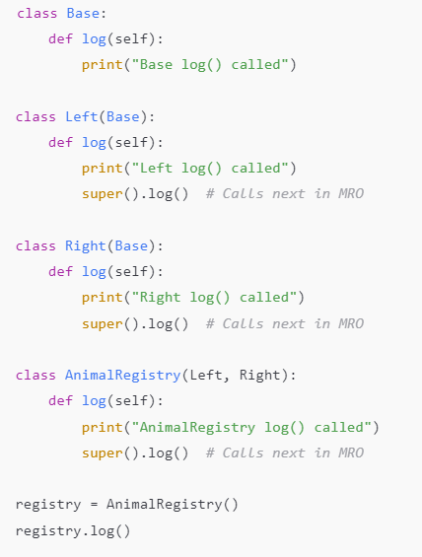
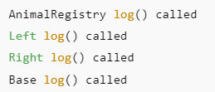

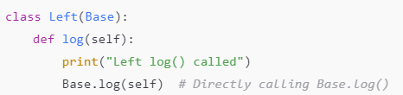
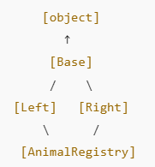
Handling Multiple Inheritance using super(AnimalRegistry,cls)
Use Python 3+ instead!!
super() just works!
Method Resolution Order (MRO): C3 Linearization: Left-right in same level
(the dreaded) Diamond
IT560: Creational Design Patterns: Singleton
Sourish Dasgupta

Slide 11
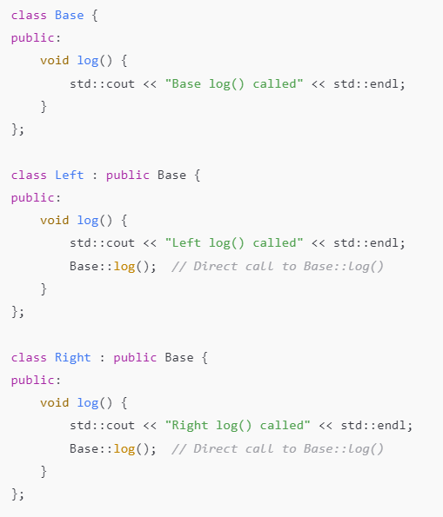
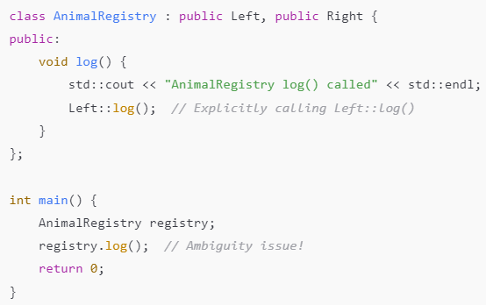

Handling Multiple Inheritance: Is C++ Any better?
No super() !!
Method Resolution Order (MRO): C3 Linearization: Left-right in same level
Compiles and runs though!!
IT560: Creational Design Patterns: Singleton
Sourish Dasgupta

Slide 12
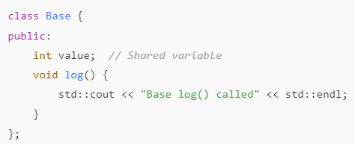

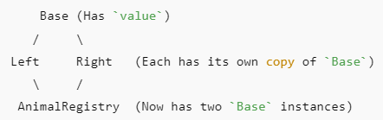
Handling Multiple Inheritance: The Dreaded Diamond
IT560: Creational Design Patterns: Singleton
Sourish Dasgupta

Slide 13

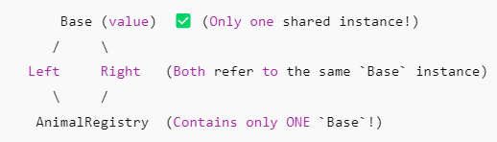
Handling Multiple Inheritance: Solving the Dreaded Diamond
IT560: Creational Design Patterns: Singleton
Sourish Dasgupta

Slide 14
Be careful with Singletons!
IT560: Creational Design Patterns: Singleton
Sourish Dasgupta

Slide 15
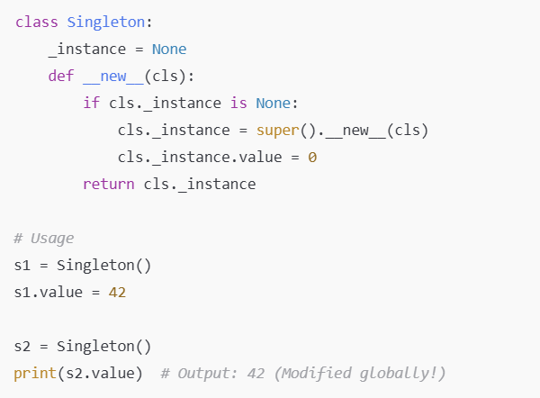
Singleton Design Pattern : Beware of global instances!
IT560: Creational Design Patterns: Singleton
Sourish Dasgupta

Slide 16
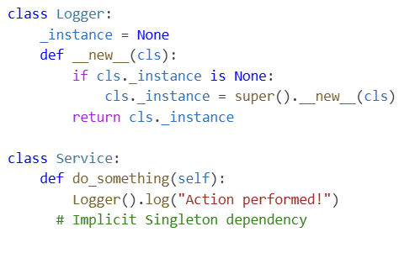
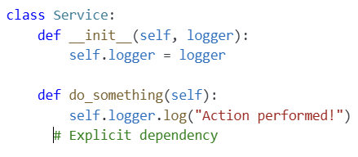
Singleton Design Pattern : Beware of silent dependencies!
Logger swappable
Dependency Injection
(testing/alternatives easy!!)
IT560: Creational Design Patterns: Singleton
Sourish Dasgupta

Slide 17
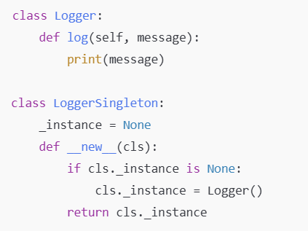
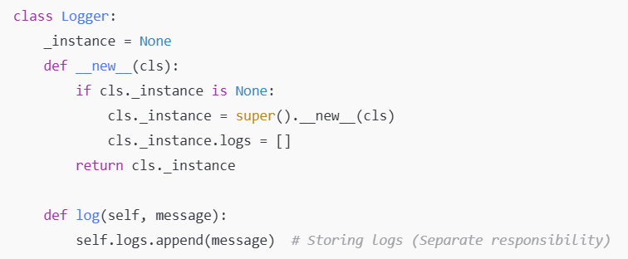
Singleton Design Pattern: Breaking Single Responsibility Principle (SRP)
IT560: Creational Design Patterns: Singleton
Sourish Dasgupta

Slide 18
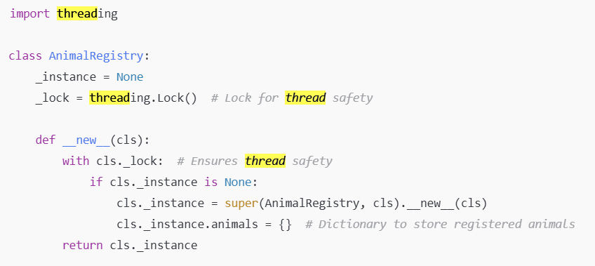
Singleton Design Pattern : Beware of multi-threading!
Prevent multiple threads from accessing in parallel
IT560: Creational Design Patterns: Singleton
Sourish Dasgupta

Slide 19
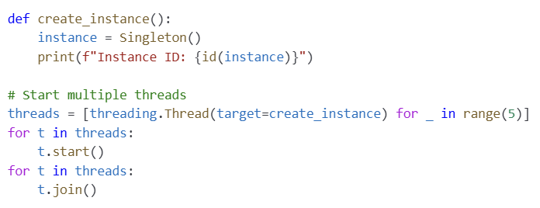
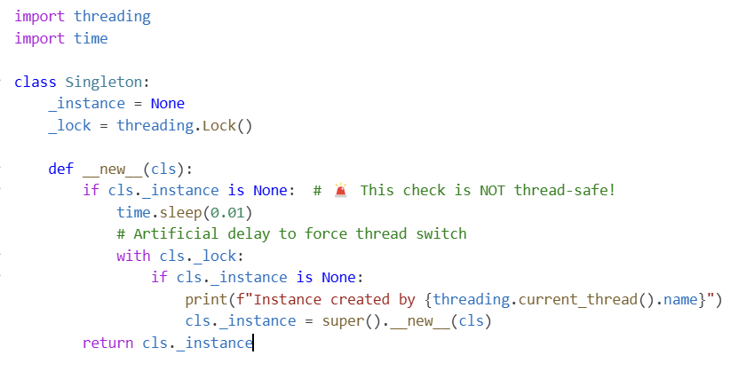
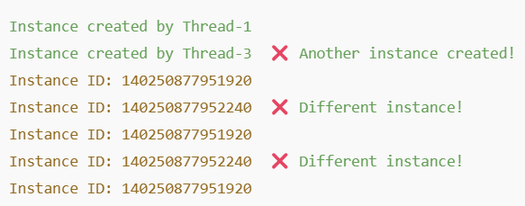
Singleton Design Pattern : Beware of concurrent threads!
IT560: Creational Design Patterns: Singleton
Sourish Dasgupta

Slide 20
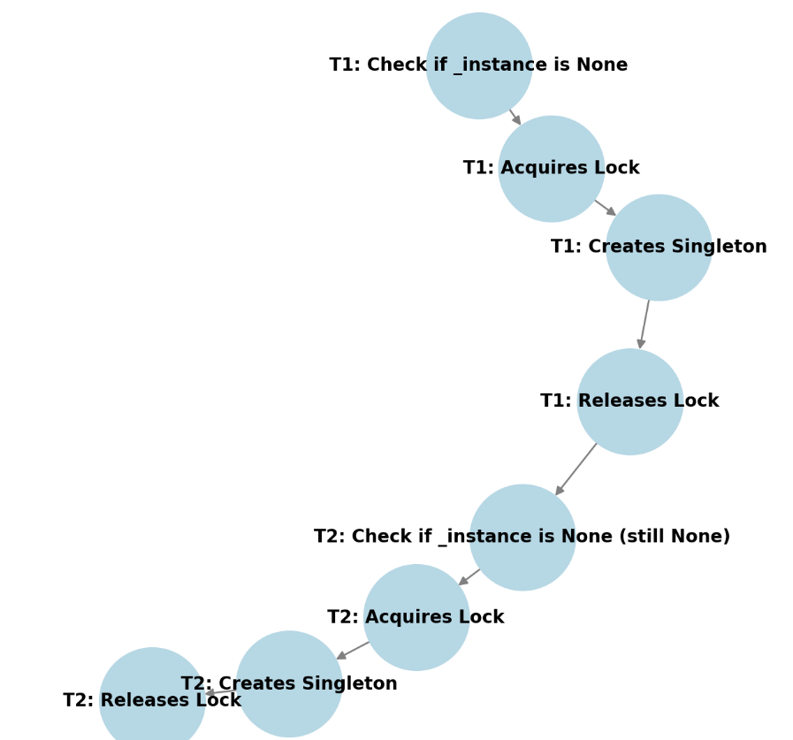
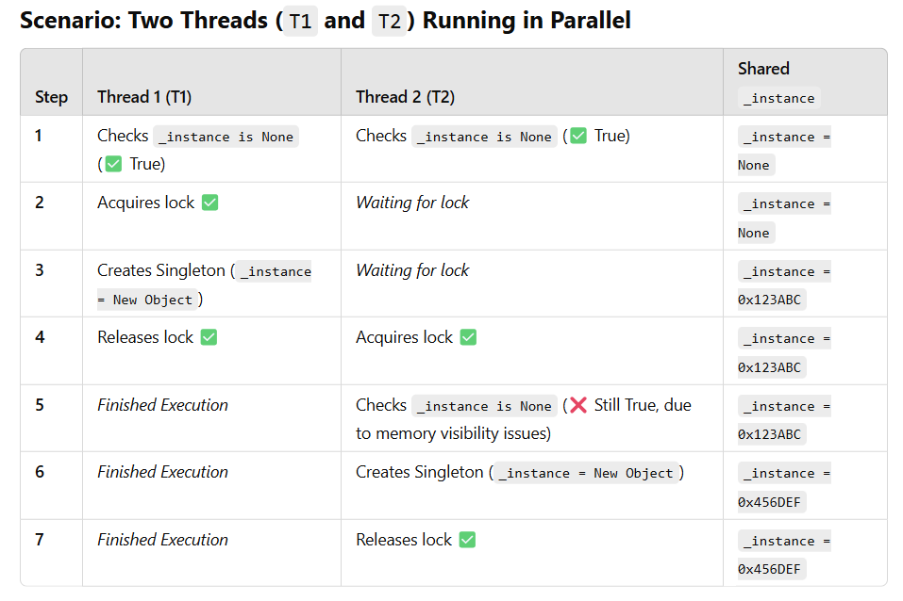
Singleton Design Pattern : Beware of concurrent threads!
IT560: Creational Design Patterns: Singleton
Sourish Dasgupta

Slide 21
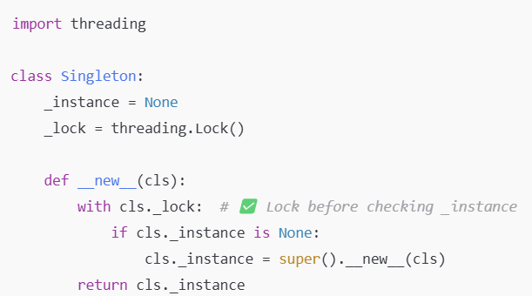
Singleton Design Pattern : Beware of concurrent threads!
Double-checking
(performance booster)
If GIL then still ok, else Python can be tricky!
IT560: Creational Design Patterns: Singleton
Sourish Dasgupta

Slide 22
Singleton Design Pattern : Beware of multi-threading!
Problem | Why is it Bad?
1️⃣ Introduces Global State | Makes debugging harder because any part of the code can change the shared instance.
2️⃣ Hidden Dependencies (Bad Design) | Code that depends on a Singleton does not explicitly state its dependency, making it harder to understand.
3️⃣ Breaks the Single Responsibility Principle (SRP) | Singleton both manages its instance and performs logic, violating SRP.
4️⃣ Hard to Mock in Unit Tests | Since the Singleton forces a single instance, replacing it with a mock object in tests is difficult.
5️⃣ Causes Thread-Safety Issues | A poorly implemented Singleton can lead to race conditions in multi-threaded environments.
IT560: Creational Design Patterns: Singleton
Sourish Dasgupta

